Slide 1





Accredited By NAAC with “A” Grade
(IAO9001-2015 and ISO14001-2015 certified institute)
(IAO9001-2015 and ISO14001-2015 certified institute)
Accredited By NAAC with “A” Grade
December -2021
December -2021
Vol-VII Issue-2
Vol-VII Issue-2
EEE MAGAZINE
EEE MAGAZINE
Power is Knowledge…Knowledge is Power.
MISSION
Power is Knowledge…Knowledge is Power.
MISSION
VISION
VISION
To implement path breaking students centric education methods
To augment talent, nurture team work to transform to develop individual as responsible citizen
To educate the students and faculties about entrepreneurship to meet vibrant requirements of the society
To strengthen industry -institute interaction for knowledge sharing
To Create globally competent Electrical and electronics Engineers who can contribute to the growth of the nation and serve the society.
* To impart students centric quality education
*To nurture the talents and impart moral values to the students
*To keep abreast the technical knowledge among
To be a best institution imparting quality engineering education to deal with community needs through learning and performance
students and faculty with industry-Academia interaction.
*To enrich Research and Innovation methods in students and faculty
Statement Of PEO’s
Graduate Engineers will be able to:
PEO 1:Apply scientific, Mathematics and Engineering fundamentals gained to comprehend,analyse,design and create products and solutions for real life problems PEO2:Contribute to industrial services and government organisations by applying their skills gained through formal education.
PEO3:Work on emerging technologies with professional communities,higher eduation ever developing careers to strengthen human values and social responsibilities to contribute towards society.
PEO4:Adopt professional and ethical attitude for effectively resolving societal problems through multidisciplinary approach
Statement Of PEO’s
Graduate Engineers will be able to:
PEO 1:Apply scientific, Mathematics and Engineering fundamentals gained to comprehend,analyse,design and create products and solutions for real life problems PEO2:Contribute to industrial services and government organisations by applying their skills gained through formal education.
PEO3:Work on emerging technologies with professional communities,higher eduation ever developing careers to strengthen human values and social responsibilities to contribute towards society.
PEO4:Adopt professional and ethical attitude for effectively resolving societal problems through multidisciplinary approach
Contents
1.Vision Mission 2.Message
3.Paper Publication 4.Faculty Participation 5.Students’ Placement 6.Webinar
7. Quiz Competition 8.Add On course
Topper List
Students’Article
Editorial Team:
Associate Professor: Prof. Rekha SN
Assistant Professors:
rof.Shivaraj A Prof. Preetha NP
Student Coordinators:
Balaji A
Tejas K N
Anusha R
Vishwanth GM
Contents
1.Vision Mission 2.Message
3.Paper Publication 4.Faculty Participation 5.Events
6. Student placement
7. Art and photography
8. Students’Article
Editorial Team:
Associate Professor: Prof. Rekha SN
Assistant Professors:
Prof.Shivaraj A Prof. Preetha NP
Student Coordinators:
Balaji
Tejas K N
Anusha R
Vishwanath G M

Slide 2

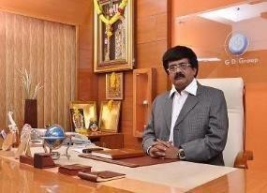

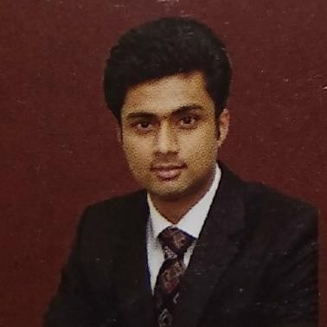

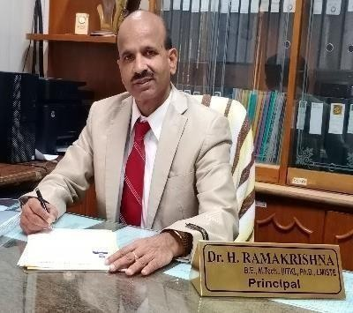
Chairman: Sri G. Dayanand
The " EEE MAGAZINE” is providing great space for the faculty and students to pen down their innovative ideas, imagination and perceptions to show case their creativity. So, I take the opportunity to congratulate the department of EEE and its editorial team to successful release of this issue. I am sure that students and faculty will find the content of this edition very interesting and educating.
Executive Director: Sri G. D Manoj
I am indeed happy to know that the department of EEE has taken initiative in realizing its " EEE MAGAZINE” and urge faculties and students to make use of the platform to share and educate among themselves in publishing article pertaining to the emerging domain and articles of interesting. I congratulate the team of editorial community and department of EEE
Principal’s Message- Dr. H Ramakrishna
It gives me immense pleasure to note that, SCE has been publishing bi- annual newsletter and I am sure, this will provide an opportunity for the faculty and students to share their knowledge and beacon the information about various issues and activities that are being taking place in the department. I look forward for more activities and achievements for the department to march towards excellence in the future. I would like to thank all teaching, supporting staff and our beloved students for their active participation in publishing this magazine. My special compliments and congratulation to the editorial team of the department for their consistent effort in publishing this newsletter.

Slide 3
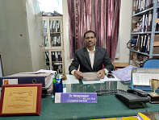
HOD’s MESSAGE: Dr. Narayanappa
It gives me great pleasure to congratulate students, teachers and staff of electrical and electronics department for the publication of newsletter. Newsletter is believed to be a focus of the inside activities i.e. academics, students and faculty achievement as well as innovation occurring in the department.
In the era of engineering and technology this newsletter will motivate the teachers and students of sharing their creativity and new ideas with the world and will help in their overall development. I wish best of luck for all the team members for publication of newsletter.
PAPER PUBLICATION
Name of the Teacher (s) | Title of Paper | Publication citation | Month and year | Vol/Issu e | Remark s
Mrs. Swetha G | “Power Quality Improvement Of Distribution Network Reconfiguration | Harbin Gongye Daxue Xuebao/Journal of Harbin Institute of Technology, JHIT, | september 2021 | Vol. 53 Iss. 11 | ” ISSN: 0367-6234
Peace Be Amplified World Be Rectified

Slide 4

FACULTY PARTICIPATION
Dr. Narayanappa | "Self Driving Garbage Collecting Electrical Vehicle | IJRAR | september 2021 | ,Volume 8,Issue 3, | E-ISSN 2348-1269, P-ISSN 2349-5138 pp352-354
Mrs. Swetha G | “Distribution network reconfiguration and reconstruction for power loss minimization using generous transformative optimization strategy”. | International Journal of Electrical Engineering and Technology (IJEET) | Issue12 DEC-2021 | Volume 12. | ISSN: 0976-6553
`1. Dr. Narayanappa Professor and Head from Dept. of EEE attended AICTE Training and Learning (ATAL) online Faculty development program on 5-day online FDP on the theme “Recent advancements in Electric vehicle technology” organized by All India Council for Technical Education(AICTE) from 18 October, 2021 to 23 October, 2021.
2. Dr. Raghavendra G Associate professor from Dept. of EEE attended AICTE Training and Learning (ATAL) online Faculty development program on 5-day online FDP on the theme “Inculcating Universal Human Values in Technical Education”

Slide 5
organized by All India Council for Technical Education(AICTE) from 13 September, 2021 to 17 September, 2021.
3. Dr. Raghavendra G Associate professor from Dept. of EEE attended AICTE Training and Learning (ATAL) online Faculty development program on 5-day online FDP on the theme "Applications of IoT in Smart Grid Systems" from 04-10-2021 to
08-10-2021 at Misrimal Navajee Munoth Jain Engineering College.
4. Mrs. Ashwini C Assistant professor from Dept. of EEE attended AICTE Training and Learning (ATAL) online Faculty development
program on 5-day online FDP on the theme "Artificial Intelligence in the Renewable Power Generation" from 18/10/2021 to 22/10/2021 at University of Lucknow.
5. Mrs Jhansi K Assistant professor from Dept. of EEE attended AICTE Training and Learning (ATAL) online Faculty development program on 5-day online FDP on the theme "Applications of IoT in Smart Grid Systems" from 04-10-2021 to 08-10-2021 at Misrimal Navajee Munoth Jain Engineering College.
6. Mr Shivaraj A Assistant professor from Dept. of EEE attended AICTE Training and Learning (ATAL) online Faculty development program on 5-day online FDP on the theme. "Artificial Intelligence in the Renewable Power Generation" from 18/10/2021 to 22/10/2021 at University of Lucknow.
7. .Mrs. Preetha N P Assistant professor from Dept. of EEE attended "Emerging Technologies (IOT, Robotics & UAV)" from 2020-10-12 to 2020-10-16 at Centre for Development of Advanced Computing.
8. Mr Shivaraj A Assistant professor from Dept. of EEE attended AICTE Training and Learning (ATAL) online Faculty development program on 5-day online FDP on the theme. "3D Printing and Design" from 25/10/2021 to 29/10/2021 at Centre for Electronic Governance.
9. Mrs. Sumangala S Jambli Assistant professor from Dept. of EEE attended National Level One Week Faculty Development Program on “Recent Development in Green Technologies" organized by

Slide 6
Department of Electrical and Electronics Engineering, ATME College of Engineering, Mysuru, held from 24th- 29th September 2021.
10. Mr.Akshay kumar D Assistant professor from Dept. of EEE attended Five day online faculty Development programme on “Part
Universal Human Value Refresher 1” organized by AICTE from 30th August 2021 to 4th September 2021
11. Mr.Akshay kumar D Assistant professor from Dept. of EEE attended One-Day Online Workshop on "How to Conduct the Student Induction (SIP) Program" on 20th September, 2021 organized by AICTE.
12. . Mrs. Ramya M Assistant professor from Dept. of EEE attended AICTE Training and Learning (ATAL) online Faculty development program on 5-day online FDP on the theme "Applications of IoT in Smart Grid Systems" from 04-10-2021 to 08-10-2021 at Misrimal Navajee Munoth Jain Engineering College
Technical Talk ON “Present Market Scenario for JOB Opportunity and Discussion on AI Analytics and the New Machine Age”
Department of Electrical and Electronics has arranged a technical talk on “Present Market Scenario for JOB Opportunity and Discussion on AI Analytics and the New Machine Age” to the students of EEE on 13/11/2022 department Mr. Nitish Alumni of EEE Dept. and Program Manager, SILRES ENERGY SOLUTIONS Pvt Ltd. Bengaluru.
The session was very interactive, where he explained the JOB Opportunity and Discussion about on AI Analytics, New Machine Age and its importance towards the upcoming generations about the technical skill set required to meet Present Market Scenario was explained very well. The students of EEE department are highly satisfied with the talk given by resource person and many students interacted with resource person after session over.

Slide 7
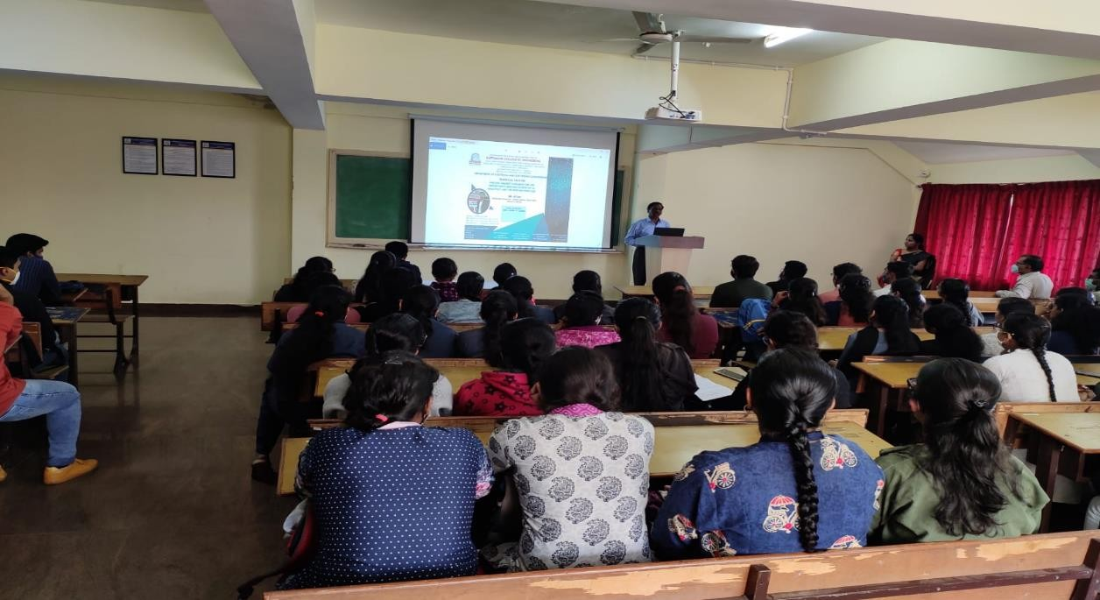
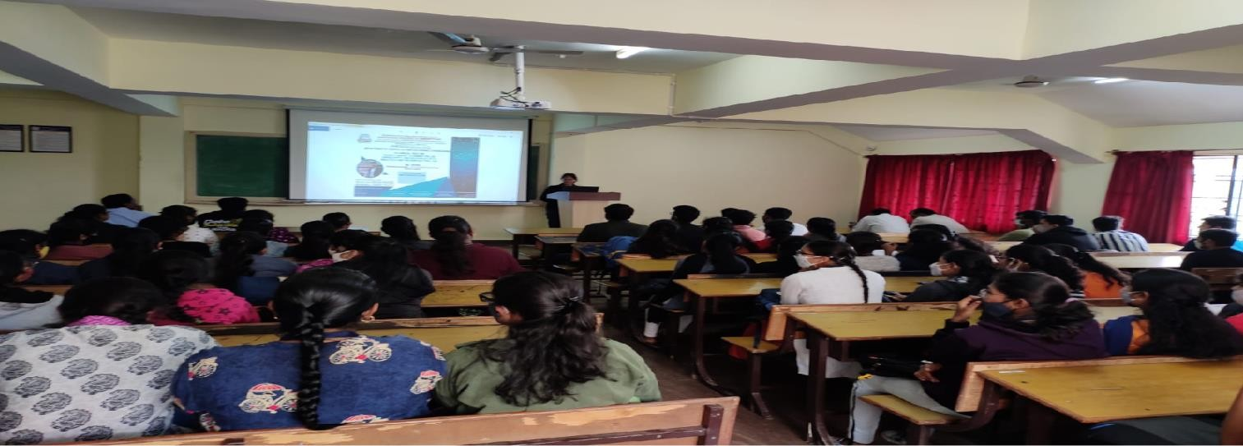
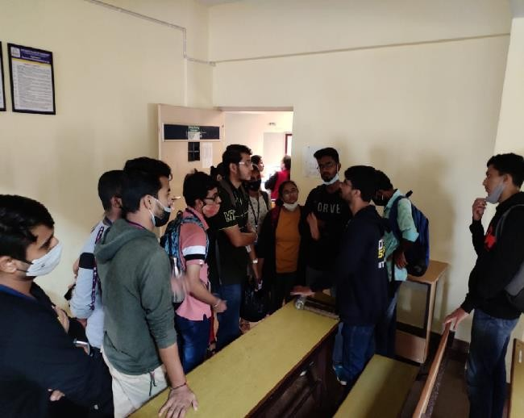
WORKSHOP ON “PCB Design and IOT”
A Five-day hands-on workshop on “PCB Design and IoT” was conducted from 22/11/2021 to 26/11/2021 in association with M/s. Ti2 Technologies, Bangalore. Mr. Rakshith B, Founder and Managing Director, Ti2 Technologies, Bangalore has given consent to be resource person for the five-day hands-on workshop. Ti2 Technologies is a leading Manufacturer, Service Provider and Supplier of Programmable Logic Controllers, Programmable Automation Controllers.

Slide 8
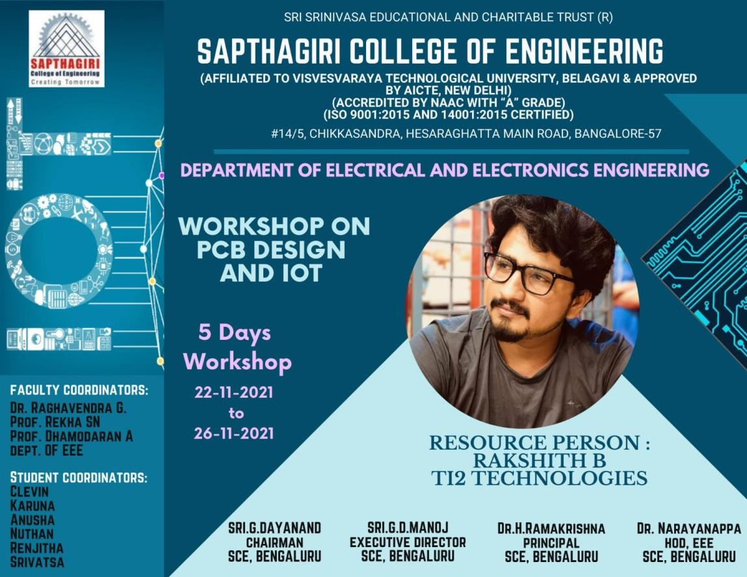
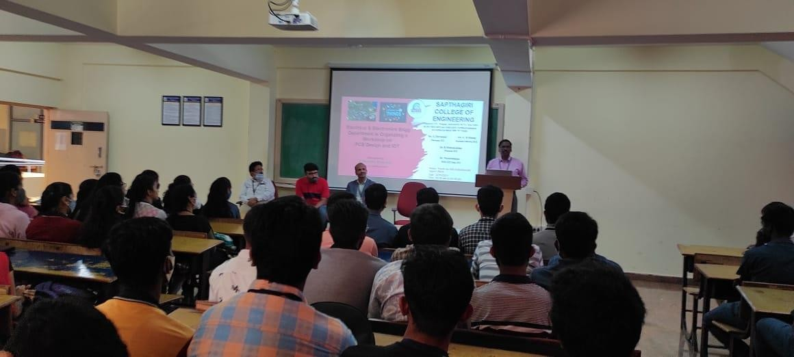
This five-day hands-on workshop was conducted for the pre-final year students of EEE with no. of participants as 86.Mr. Rakshith B, was given detailed view of basics in Digital System Design and Analog Electronics Circuits. In addition, he emphasized on Internet of Things and need of skilled professionals in the job market. He explained in detail about the various software used in IoT and to design various electronic circuits. Further, he elaborated and given hands-on experience about different types of microcontrollers and designing and manufacturing of multi-layer PCBs. The custom design and fabrication of PCBs was carried out hands-on by the participants in this workshop.
This hands-on workshop satisfies the need of skill development in design and fabrication of PCBs and interfacing with IoT.

Slide 9
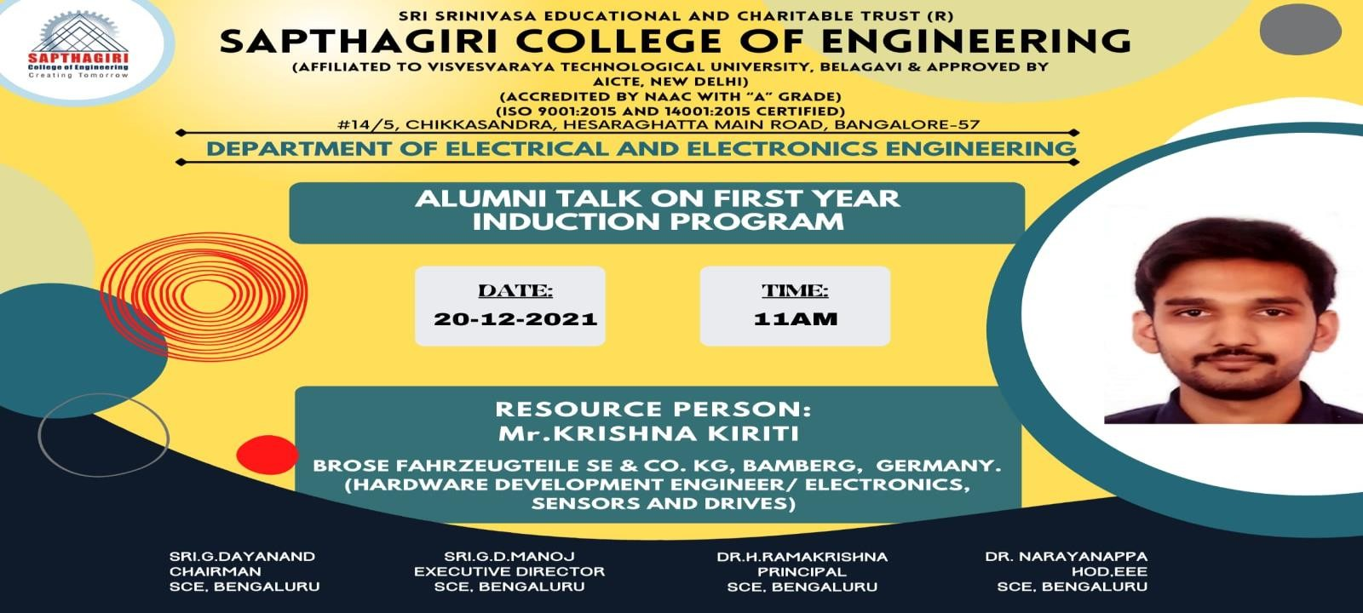
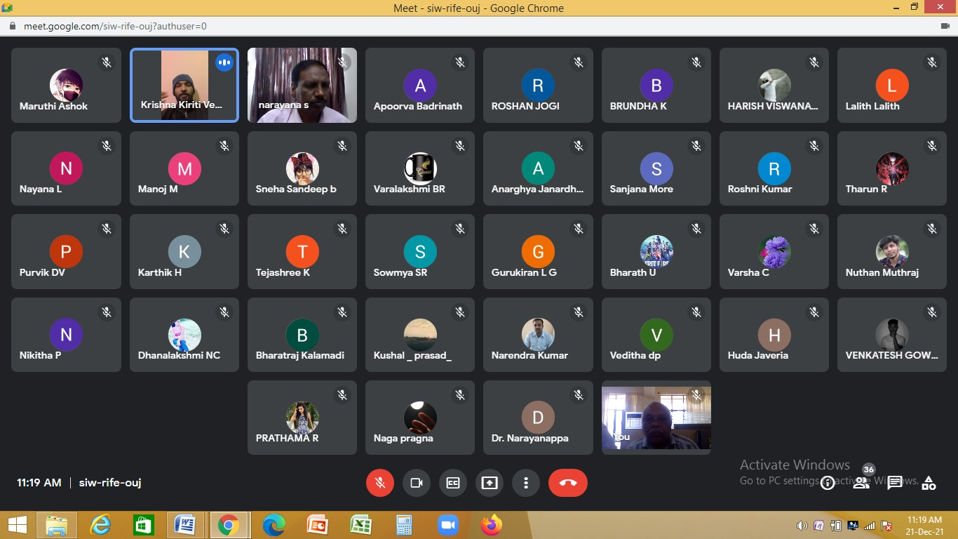
AlUMNI TALK ON “First Year Induction Program”
The Department of Electrical and Electronics Engineering is organized Alumni talk on “First Year Induction Program” 20/12/2021 for 1st Semester students.Ourpride Alumni Mr. KRISHNA KIRITI, BROSE FAHRZEUGTEILE SE & CO.KG, GERMANY, (HARDWARE DEVELOPMENT ENGINEER/ELECTRONICS, SENSORS AND DRIVERS), He
spoke about the Electrical and Electronics Engineering department, faculty, and curriculum. He addressed the difficulties he encountered during his four-year UG journey. He inspired students studying in Electrical and Electronics and also Shares career opportunities in the Electrical field.

Slide 10
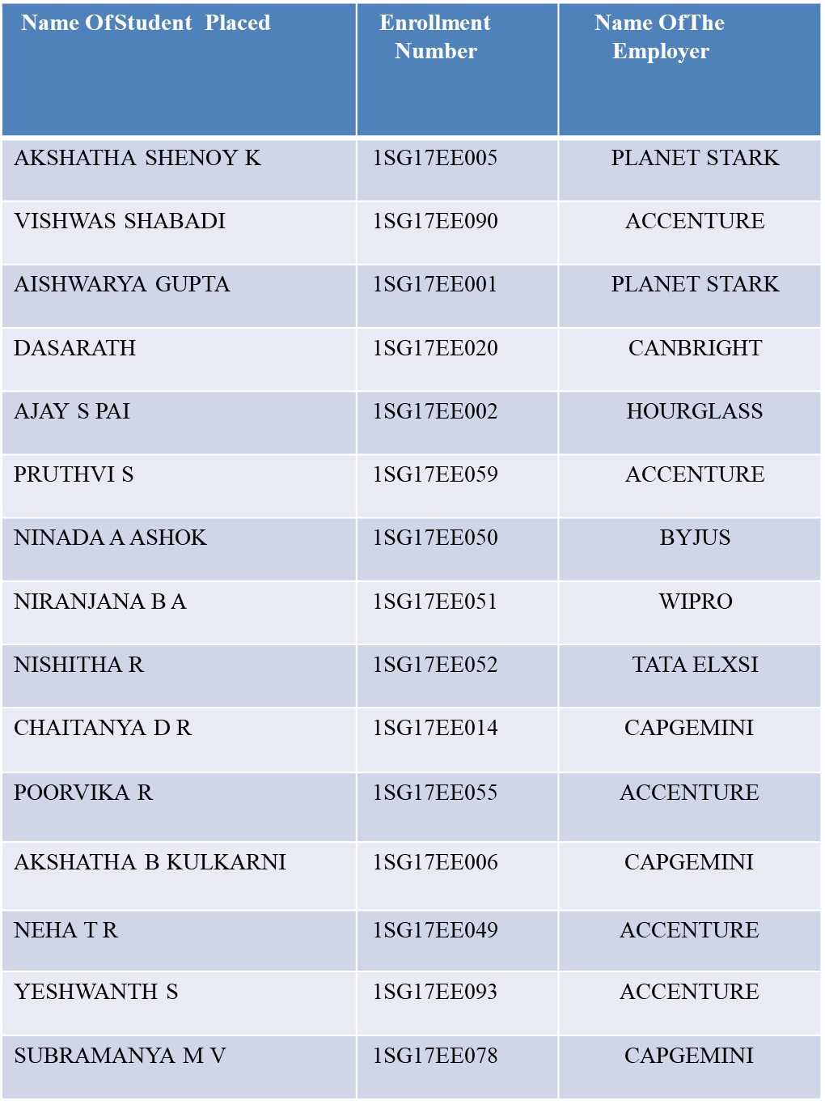
Students’ Placement :

Slide 11
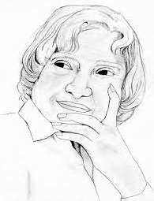
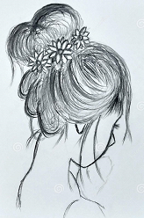

Students Art and Photography
BHAVANA C, V– Sem A-Sec
KARUNA N –V Sem A-Sec
BALAJI A, VII– Sem A-Sec

Slide 12
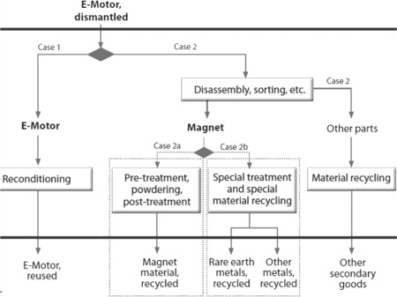
TECHNICLE ARTICLE
Electric cars: technical characteristics and environmental impacts
Electric vehicles have been identified as being a key technology in reducing future emissions and energy consumption in the mobility sector. The focus of this article is to review and assess the energy efficiency and the environmental impact of battery electric cars (BEV), which is the only technical alternative on the market available today to vehicles with internal combustion engine (ICEV). Electricity onboard a car can be provided either by a battery or a fuel cell (FCV). The technical structure of BEV is described, clarifying that it is relatively simple compared to ICEV. Following that, ICEV can be ‘e-converted’ by experienced personnel.
Practicability of today's BEV is discussed, revealing that particularly small-size BEVs are useful. This article reports on an e-conversion of a used Smart. Measurements on this car, prior and after conversion, confirmed a fourfold energy efficiency advantage of BEV over ICEV, as supposed in literature. Preliminary energy efficiency data of FCV are reviewed being only slightly lower compared to BEV. However, well-to-wheel efficiency suffers from 47% to 63% energy loss during hydrogen production.
Name of the Student:Chirag KS
USN No:1SG18EE026
7th Sem

